Slide 1
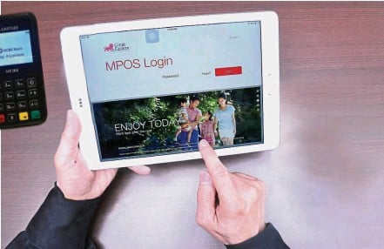
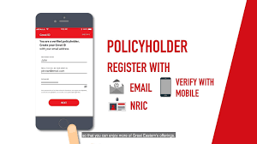

Slide 2
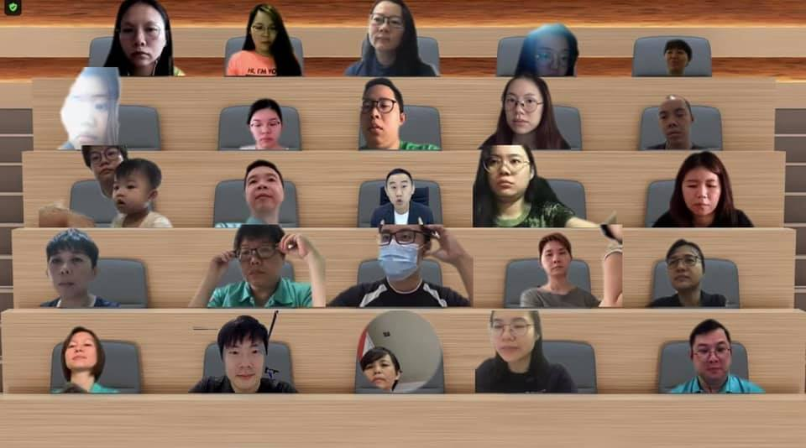
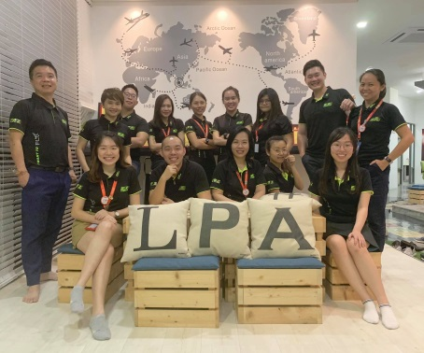
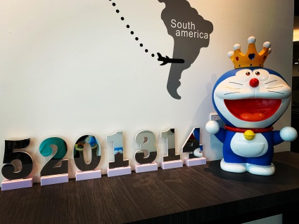
LPA TEAM
CSR
KEEP LEARNING
WORK HARD
PLAY HARD
RFP, CFP, FCLP etc
5201314
GIVE WHAT YOU GAIN
ENVIRONMENT
WORKABLE AND PRACTICAL SYSTEM
BLOOD DONATION FAMINE 30
GOTONG ROYONG.
WORK LIFE BALANCE
TEAMWORK
LEARNING
WORKING TIME
LEISURE TIME
FAMILY TIME
ACTIVELY AT SOCIAL MEDIA
YOUNG AND ENERGETIC TEAM
SYSTEM

Slide 3
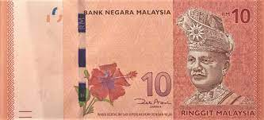
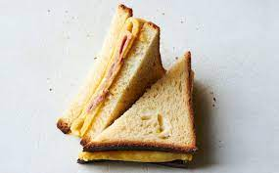
你觉得一天 RM10 可以买些什么？

Slide 4
其实，RM10 可以好好的规划

Slide 5
创造4类有意义的商品 ：
1. 你死亡，我理赔 —与寿险有关
2. 你生病，我理赔 —与收入保障产品有关
3. 你退休，我支付 —与退休规划的产品有关
4. 小孩上学，我支付 —与孩子的教育产品有关

Slide 6
保险的经验法则：
年收入的10倍，是寿险所需的保障
年收入的5倍，是作为收入所需的保障
20% 的收入，是退休规划所需
5%的收入，是教育基金所需

Slide 8
Agent Basic Commision
(Investment Link Policy)
Total Commission for 6 Years up to 117% for Premium Received each year for Investment Link Plans!*
1st. Year Commission on FYLPI up to 28%
2nd. Year Renewal Commission up to 28%
3rd. Year Renewal Commission up to 15.5%
4th. Year Renewal Commission up to 15.5%
5th. Year Renewal Commission up to 15%
6th. Year Renewal Commission up to 15%

Slide 9
